Slide 1
Tech Talk with Forrester

Slide 2
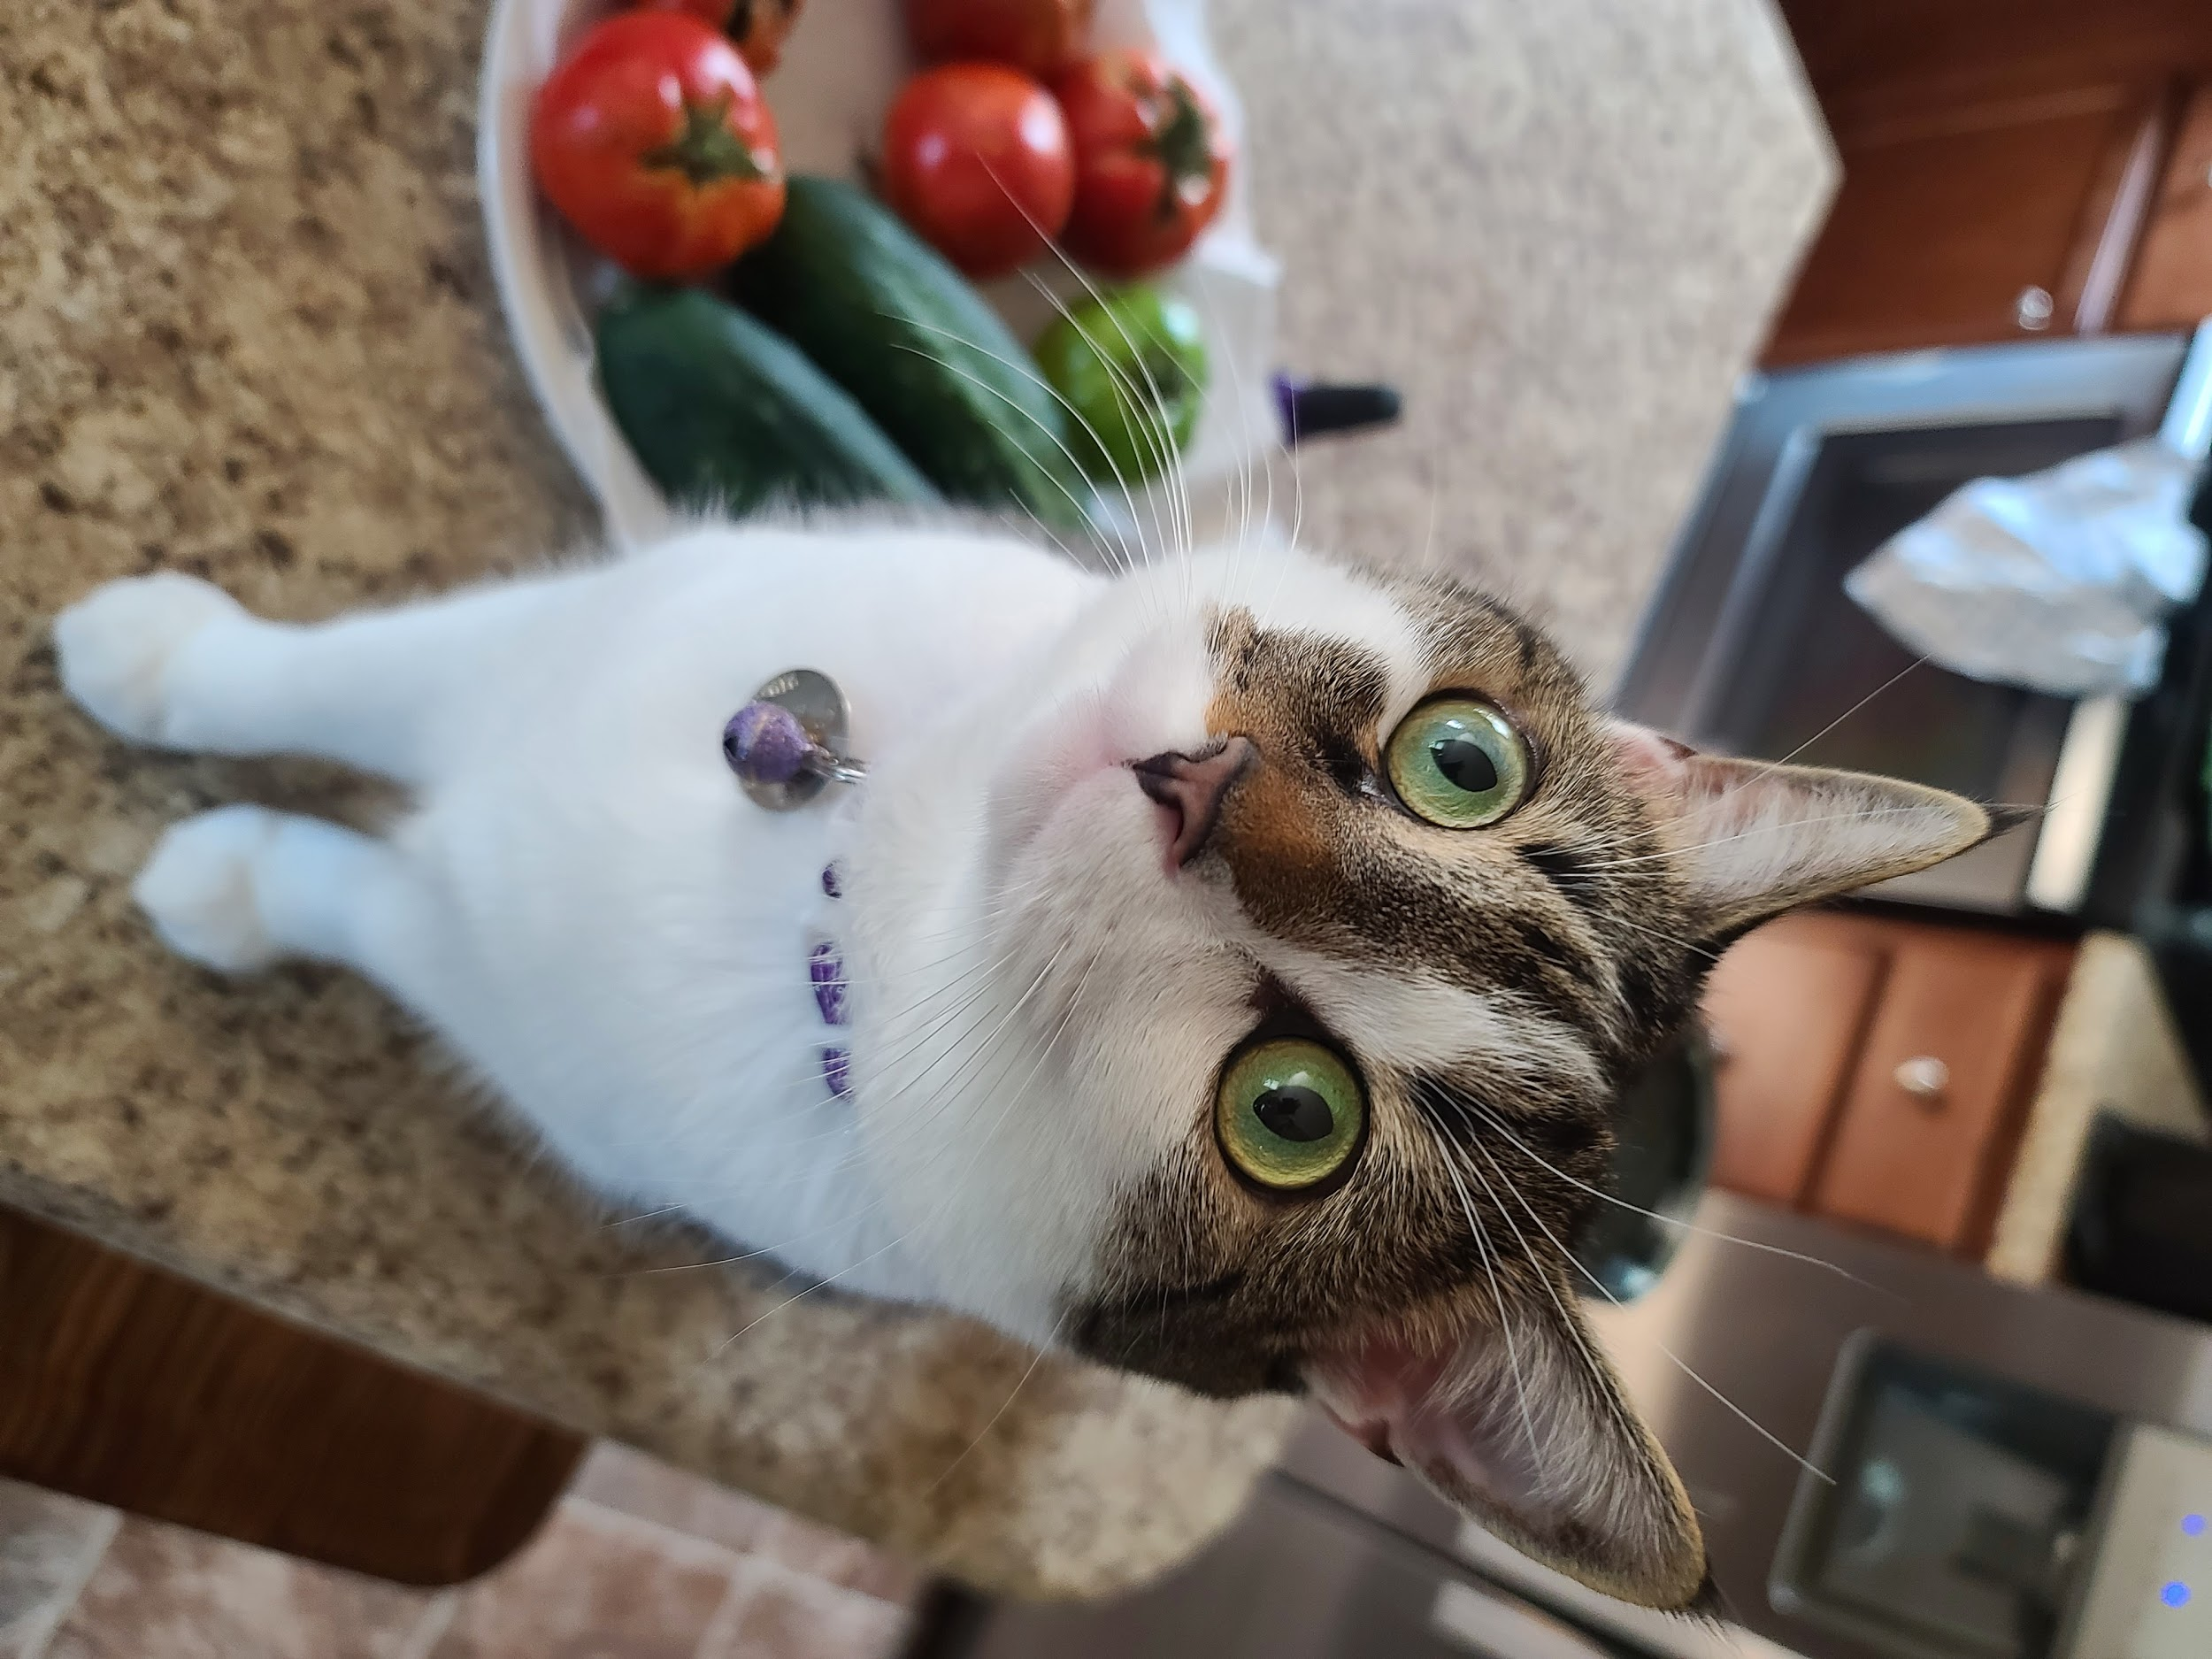
Intro and housekeeping
Parker Ennis
Senior product marketing manager, GitLab CI/CD
Lover of all things open source, sports, and music. Worked in the DevOps space for the better part of 5 years across multiple roles.
Izzy and Leo
Notes:
My name is Parker; here’s some information about who I am and what I do. I joined GitLab in January after working in the space for several years with a heavy focus on Jenkins, so CI and CD are very familiar areas, and it was a natural fit to come onboard here at GitLab to cover CI/CD. I like to say I’m a student of people so definitely feel free to find me on LInkedIn and reach out or connect, always happy to talk about DevOps, CI/CD, and grow my network
Q&A plug. Any that we don’t get to I am happy to follow up on after my time slot has ended async!
Briefly go over agenda

Slide 3
Challenges today

Slide 4
Disruptions - Digital Transformation, Pandemic, etc
Digital transformation spend is predicted to grow at 17.5% CAGR: $7.4 trillion from 2020 to 2023
Developers
Competitive Advantages in the Digital Age
Increasing Speed & Agility
Building, Deploying and Securing
Software
Optimize efficiency
Reduce business risk
New business models
Operations
Security
Notes:
We’re living in a world of digital transformation and disruption that are impacting us on so many levels. Transformation has been a concept for a long time and is only growing/evolving. Orgs that are successful dealing with pandemic were already prepared to react and respond. At the end of the day, to have an advantage you have to be able to improve speed, operate more efficiently, and ensure that you’re managing business risk while introducing new business models. Your teams have to work together to be successful and embrace change. YOU GOTTA BRING EVERYONE TOGETHER. Unified teams to build, test, and deploy software.
Go to next slide
"getting it right is much harder thanks to 2020 but there's more on the line for long term success than ever before. A lot of the problems faced by the enterprise are simple exacerbated in 2020..."
That toolchain crisis talked we about in the beginning is slowing down transformation
Siloed teams
No visibility across projects
Information silos, no innersourcing
Code integration nightmares
Constant change
Unable to keep up with demand
Painful onboarding process
Version conflicts
Broken communication
Lost information
Lack of context
https://www.idc.com/getdoc.jsp?containerId=US45569118 Oct 2019 - IDC FutureScape - Doc # US45569118 - IDC FutureScape: Worldwide Digital Transformation 2020 Predictions

Slide 5
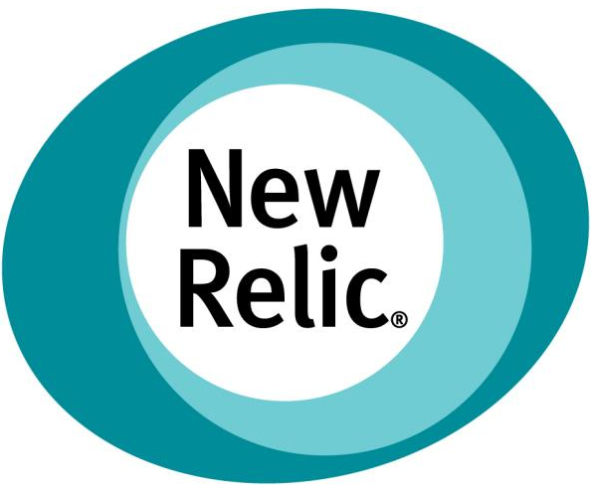
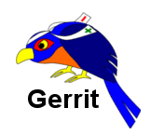
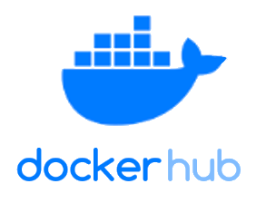
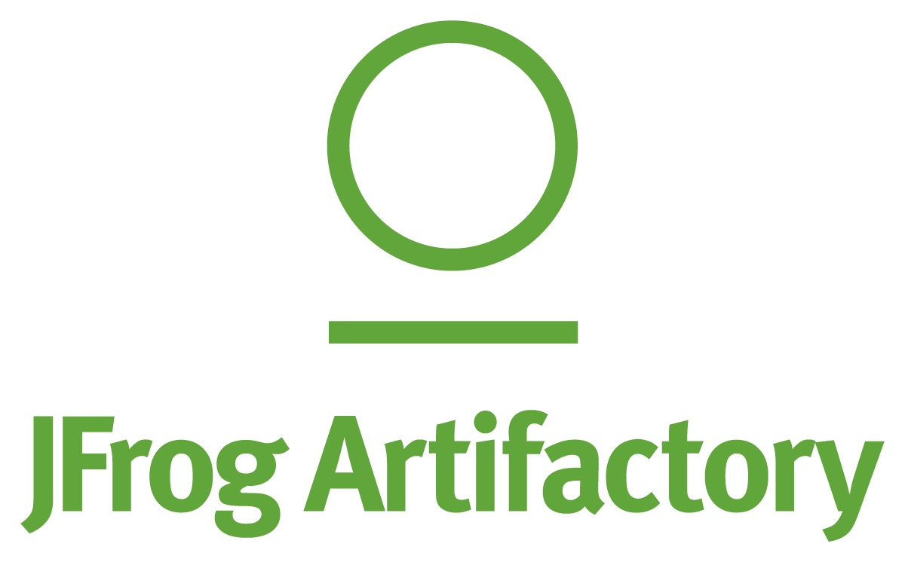
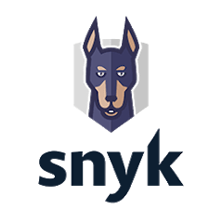
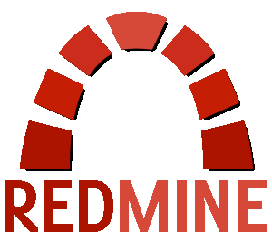
Complex Software DevOps Toolchains
Definition: DevOps is the convergence of people, processes and tools to enable adaptive IT and business agility
X
100s of Tools
X
Multiple Data Models
X
Complexity & Risk
X
Lack of Transparency
Notes:
Look, it’s no secret: “ya’ll are here because you want to know how to solve a common problem (like your peers at UBS, Goldman)...."
But guess what most organizations have architected these cobbled together Frankenstein of systems (jenkins-stein). This toolchain complexity causes risk and speed concerns So how do you respond to the challenges that we’re facing?
“Oh by the way this doesn’t work”
8.2billion spent on devops in 2019
>50% devops time wasted on logistics and repeatable tasks
87% of organizations are disappointed with results of devops
https://docs.google.com/presentation/d/14TxIJfWbwxKvPp6azUV_eLIBNhCWAwBAlBVqg64oa-0/edit#slide=id.g827db32709_0_0
100s of tools tax a system: more vulnerabilities, fragile integrations, complex to scale, reinforce silos, and inefficient to source, integrate, and administer

Slide 6
Thriving in 2020
How can I help my dev teams be more efficient/productive?
You have to simplify and streamline toolchains.
Scalability
Cloud and Cloud Native
Risk
“Shift Left” Security
Velocity
Embrace automation
Notes:
Here’s 4 pieces of advice to be successful
You have to simplify and streamline toolchains
Solve for how you can develop and deploy scalable applications
Reduce risk and shift security all the way left
And figure out how to solve for velocity. Something that is directly related to and can be achieved through CI/CD. That’s something Chris is going to dive into but I want to set the stage on why this is important
Amidst a global pandemic, change is still the only constant. Speed to market has never been more important...
You’ve got two choices:
embrace excuses
embrace solutions
“how can I help my devs and teams to be more efficient/productive that way I can ship better software faster?"
All businesses today have this problem. It’s a melting pot of tools and systems that introduce complications around maintenance and efficiently
we see this all the time and help them solve it

Slide 7
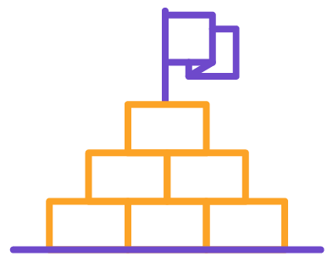
Why CI/CD?
Benefits
Getting started
Faster cycle times
Avoid manual errors
Faster feedback loops
QA and Security testing coverage
Keep compliant
Scales
Learn and understand CI/CD basics
Change the culture - the pipeline is king (all changes go through)
Iterate - quick wins
Focus on biggest source of pain
Get to your first green pipeline
Then add more detail to the pipeline and keep it green
Notes:
Benefits and value of CI/CD. Spend 3 or 4 minutes on the benefits of embracing CI/CD

Slide 8
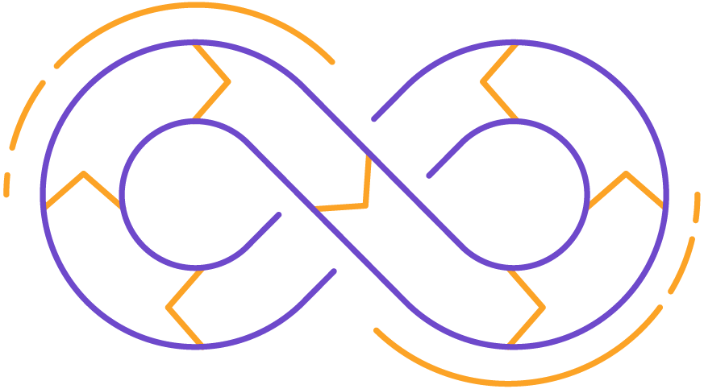
CI/CD Best Practices
Automate everything you can
Have one path to deploy to production via CI/CD pipeline
Use the cloud- containers and Kubernetes are your friends
Track important DevOps metrics
Bake in compliance and keep sensitive data isolated in your environment
Leverage YAML and templates
Beware of plugins
Start small, think big
Automate with CI first, then extend automation to CD for deployments OR
Start with production, automate deployments then work toward Dev.
Commit changes early in frequent iterations
Use cloned production environments to test locally before pushing to prod

Slide 9
About GitLab
Notes:
Let me tell you a little bit about GitLab...

Slide 10
A Complete DevOps Platform Delivered as a Single Application
Manage
Plan
Create
Verify
Package
Secure
Release
Configure
Monitor
Defend
Version Control & Collaboration
Continuous Integration
DevSecOps
Continuous Delivery
GitOps
8
Notes:
It’s one platform, that does all these things in one solution. And one of the key things I want you to take away is it is one product that solves the problem. Not just one use case - VC&C or CI/CD - but these are vital use cases. This is what people put budget around - this is what we hear you tracking, what your clients are asking about

Slide 11
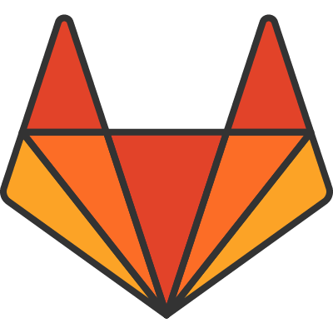
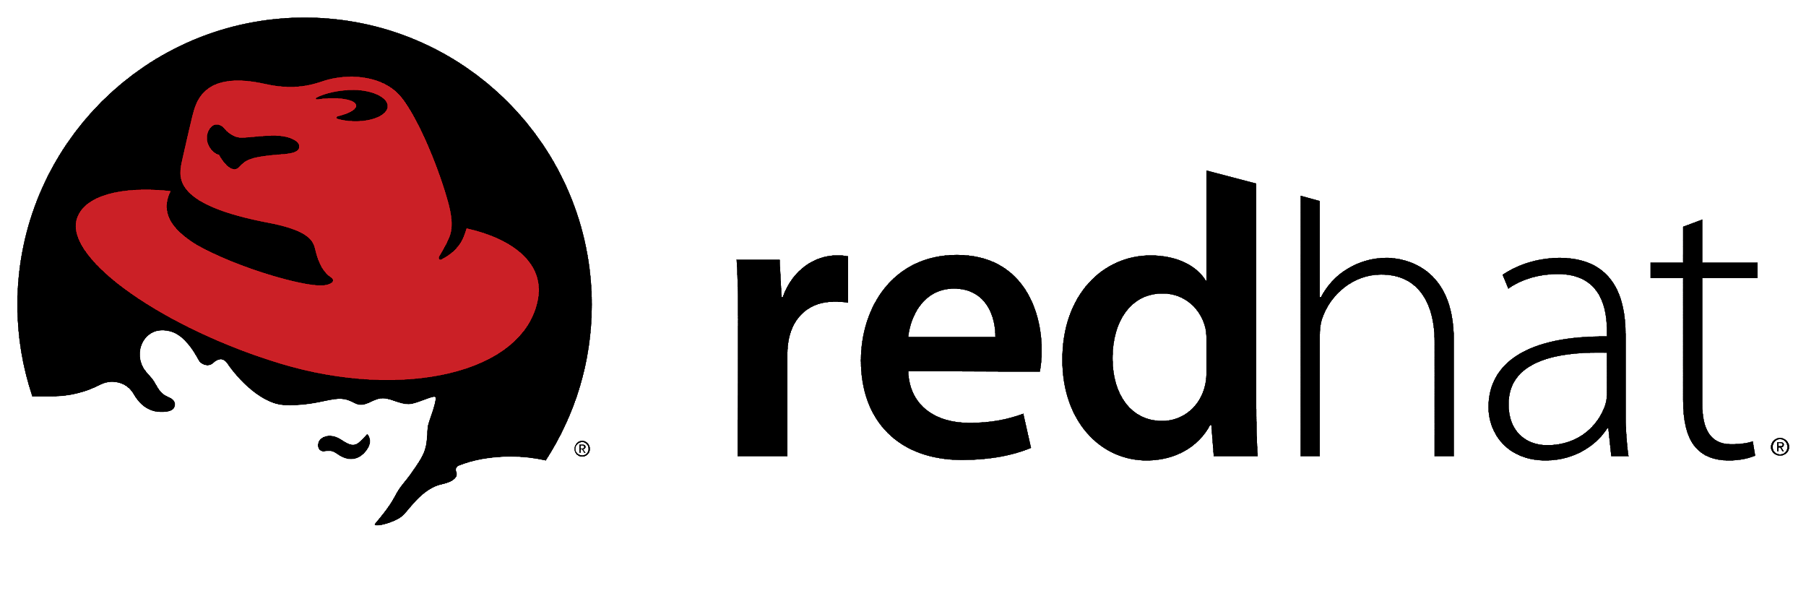
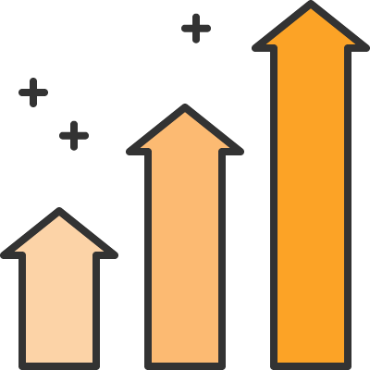
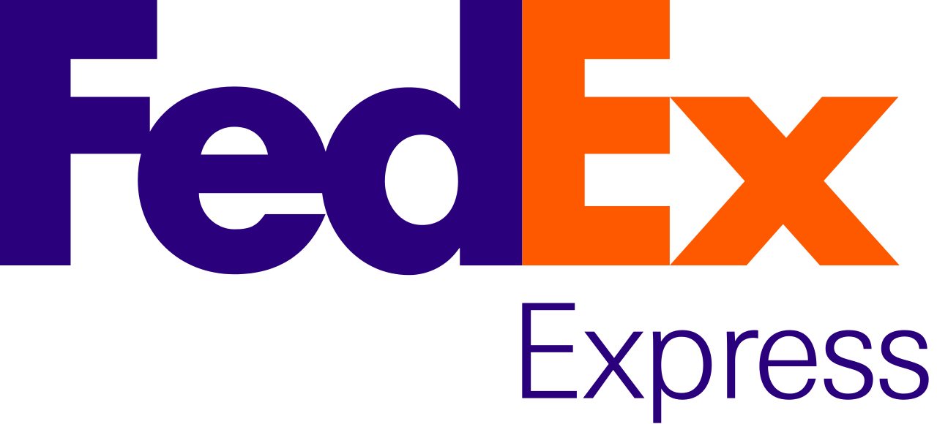
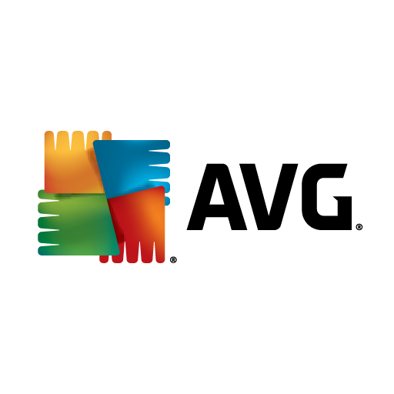
About GitLab
COMPANY
Incorporated in 2014
1300+ employees across 65 countries
GitLab Federal entity est. in 2018
BROAD ADOPTION
100,000+ organizations
Millions of users
70% share of self-managed DevOps repository market
STRONG COMMUNITY
Open source model
3000+ code contributors
10,000+ total contributors
Notes:
GitLab is in a pretty unique position within the DevOps space and a lot of people know us for our offering being a complete devops platform delivered as a single application. We started in 2014 and have been growing ever since, with 100s of thousands of organizations using and trusting GitLab to deliver their software. You probably recognize some of the names on the right. We take pride in having an open core model and a commitment to our community to drive innovation with over 2500 code contributions across the globe.
we are open.
we are transparent.
we are a community building software together where everyone can contribute.
"of course we sell software but we're a community"

Slide 12
GitLab removes toolchain complexity and accelerates DevOps adoption, shortening release cycles from once every 1-2 weeks to once every few minutes
Notes:
Just one of many examples of success within organizations that face the same problems you do…
Challenge: The firm had built its own toolchain but was looking for a solution to increase concurrent development. They wanted a modern toolset for managing code that developers coming into the firm would likely already be familiar with; this led to an evaluation of GitLab and other git-based vendor products.
Solution: GitLab is used as a complete ecosystem for development, source code control and reviews, builds, testing, QA, and production deployments. All the new strategic pieces of Goldman Sachs’ software development platforms are tied into GitLab. GitLab is helping the business-line engineering teams move faster to develop and improve their software and deliver for clients. One of the firm’s most important projects has moved from a release cycle of once every 1-2 weeks to once every few minutes because of GitLab.
RESULTS
1000+
CI feature branch builds a day by some teams
52k
test cases across 11k test classes
1500+
adopters in the first two weeks

Slide 13
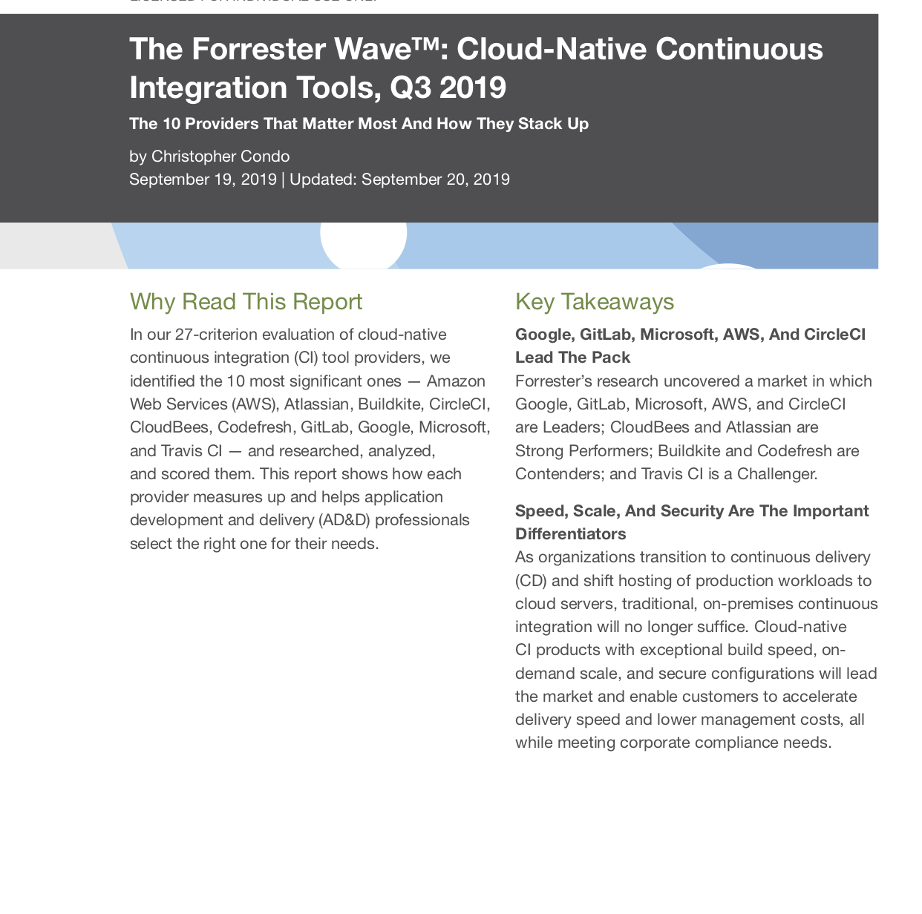
Forrester Total Economic Impact™ Study
Discover your GitLab return on investment with the Forrester Total Economic Impact™ Study and Estimator
The 2019 Forrester Wave™: Cloud-Native Continuous Integration:
See why Forrester says Google, GitLab, Microsoft, AWS, And CircleCI Lead The Pack
Notes:
Don’t take it from me… I encourage you to check out these resources and see why GitLab is right to help you with your digital transformation and optimizing your software development process

Slide 14
Thanks!
Learn more about CI/CD
Check out our CI resource page with lots of helpful links at the bottom under ‘Resources’
See how GitLab CI/CD can help you deliver better software faster
parker@gitlab.com

